Slide 1
Dangers of Bisphenol A (BPA)
BY:
Dena Amato
Vanessa Rodriguez

Slide 2
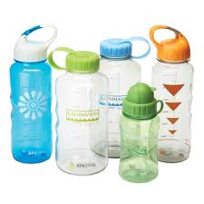
Basics
What is it?
Where is it found?
Chemical produced in large quantities for use in production of polycarbonate plastics and epoxy resins
Water and infant bottles
CDs
Medical devices
Food cans
Bottle tops
Water supply pipes
Dental sealants

Slide 3
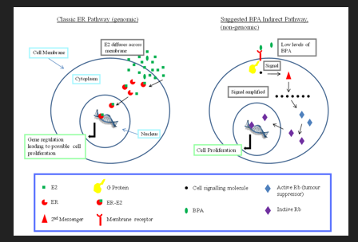
How does it enter the body?
Majority is through food and beverages
The highest daily intake of exposure is in infants and children
Can leach into food of canned food and consumer products
Leaching depends on temperatures exposed to liquid, can, or bottle rather than age of the container

Slide 4
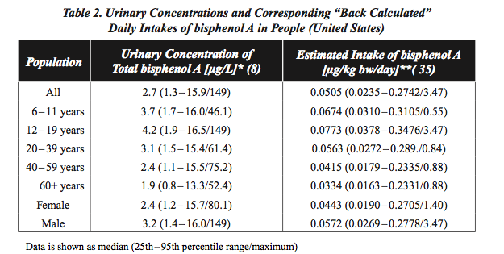
Stats
CDC found BPA in 93% of people from a sample of 2517 ages 6 and up

Slide 5
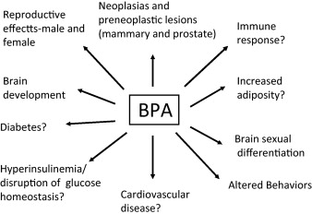
What is the concern?

Slide 6
Development and Reproduction
Studies have shown that high dose levels of BPA during pregnancy and lactation can reduce:
Maternal pregnancy weight
Fetal survival
Birth weight
Growth of offspring
Onset of puberty
Litter size (rodents)
High BPA levels can also cause:
Precancerous lesions of prostate/mammary gland
Altered prostate gland and urinary tract development
Early onset of puberty in females
Neural and Behavior alterations

Slide 7
Human Studies
Effects of Urine/Blood Concentration of total or free BPA in humans:
Hormones
Markers of DNA damage
Miscarriage
Chromosomal defects in fetuses
Fertility and obesity in women
Effects on endometrium
Polycystic ovary syndrome
Birth outcomes
Length of gestation

Slide 8
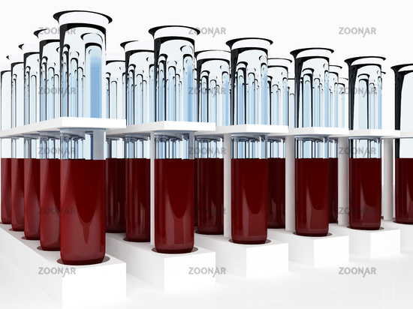
Results
Lower levels of FSH
Higher levels of testosterone: men and women
Polycystic ovary syndrome
Recurrent miscarriage
Chromosomal defects in fetuses

Slide 9
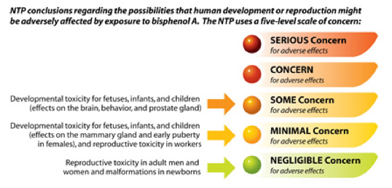

Slide 10
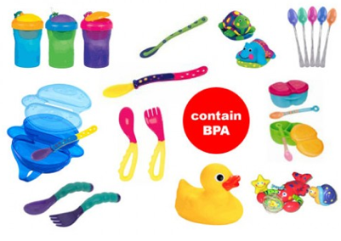
How to prevent exposure
Don’t microwave polycarbonate plastic food containers
Plastics with a 3 or 7 recycle may be made with BPA
Reduce consumption of canned food
Opt for glass, porcealin, or stainless steel particularly for hot foods or liquids
Use water and baby bottels that are BPA free

Slide 11
Sources
National Toxicology Program- CERHR
http://www.niehs.nih.gov/news/newsroom/releases/2008/september03/index.cfm
http://ntp.niehs.nih.gov/ntp/ohat/bisphenol/bisphenol.pdf (Actual Report)
National Institute of Environmental Health Sciences http://www.niehs.nih.gov/health/topics/agents/sya-bpa/

